Slide 1
Automatic Upload of Electronic Holdings
Elsevier
Yoel Kortick
Senior Librarian

Slide 2
Agenda
Introduction
The setup
The update from Elsevier
The update from Elsevier – No Change to Resource
The update from Elsevier – Resource Updated
The update from Elsevier – Resource Added
Summary
2

Slide 3
Introduction

Slide 4
Introduction
In addition to this presentation see also the online help at Upload Electronic Holdings from Elsevier.
It is possible to both import and continuously update Elsevier electronic holdings by automatically retrieving and importing the institution-specific holdings using an integration profile.
This feature is advantageous because it can replace the manual, multi-step workflow of contacting Elsevier for your specific institutional holdings, converting the provided feed to meet the Portfolio Loader format, and then uploading the holdings using the Portfolio Loader.

Slide 5
Introduction
This feature ensures that your institution-specific electronic holdings for Elsevier collections are up-to-date and reflect the purchases of the institution.
To support this capability, the following Elsevier collections must be activated by the institution from the Community Zone:
Elsevier ScienceDirect Books Complete
Elsevier ScienceDirect Journals Complete

Slide 6
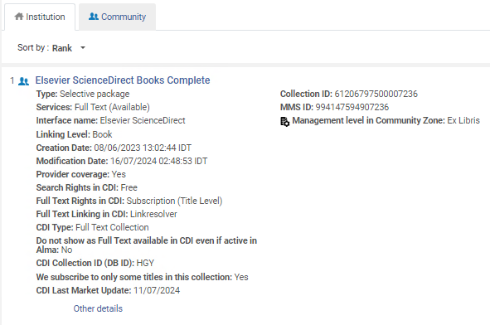
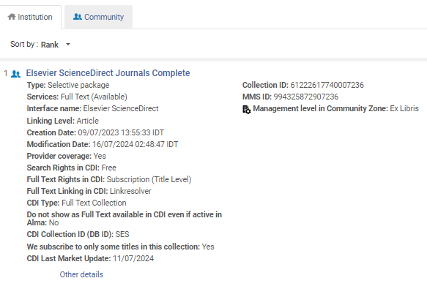
Introduction
Here are the two collections in the institution activated from the community zone. These are the collections which will be automatically updated via the “Upload Electronic Holdings” integration profile for Elsevier.

Slide 7
The setup

Slide 8
The setup
The first step is to obtain from Elsevier an institution token.
This is a token used by Elsevier to identify your institution and thereby provide the holdings files for your institution.
This token will be put into the integration profile.

Slide 9
The setup
The second step is to ensure that the Elsevier collections for which you are updating holdings are active collections in Alma.
For example (as we saw in the introduction):

Slide 10
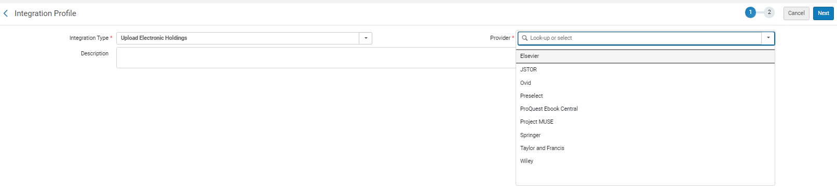
The setup
The third step is to add an integration profile of type “Upload Electronic Holdings” and choose “Elsevier” as the “Provider”.
This is done from the “Profile List” page at “Configuration > General > External Systems > Integration Profiles”

Slide 11
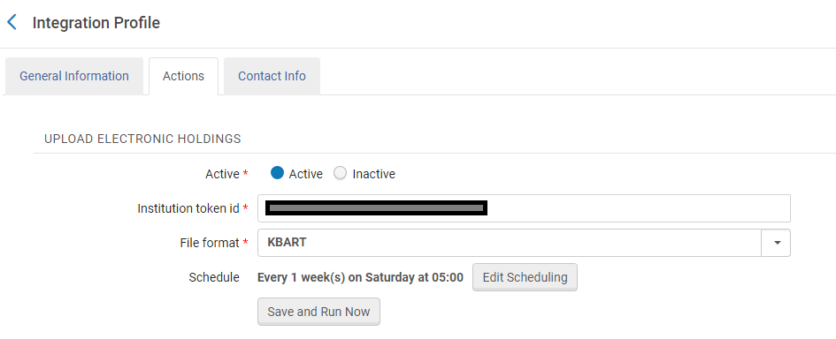
The setup
Fill in the Token ID (which you received from Elsevier), File Format = KBART, and choose scheduling option.

Slide 12
The update from Elsevier

Slide 13
The update from Elsevier
The job “Upload Electronic Holdings” for vendor Elsevier will run as scheduled. In this case, every Saturday at 05:00
If needed the job can also be run manually

Slide 14
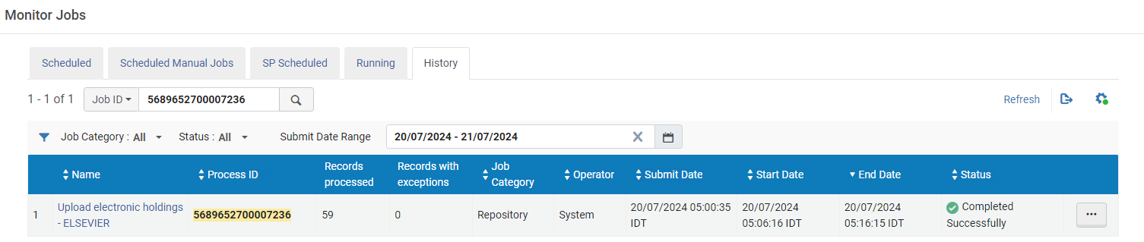
The update from Elsevier
Here from the “Monitor Jobs” we see the most recent run of the job “Upload electronic holdings - ELSEVIER” completed successfully on Saturday July 20th when it ran at 05:00 AM.
Saturday 05:00 AM

Slide 15
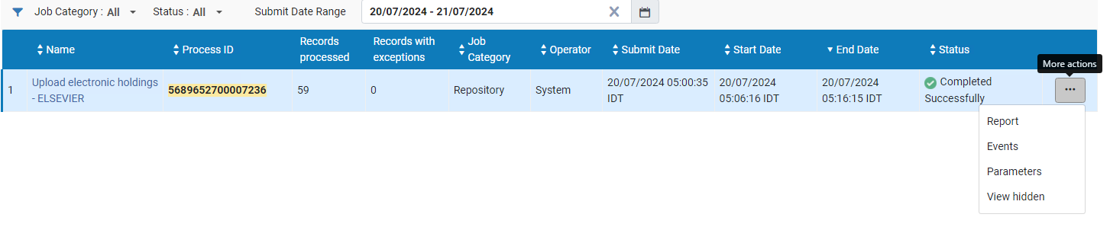
The update from Elsevier
Let’s take a look at the report for the job run on July 20, 2024.

Slide 16
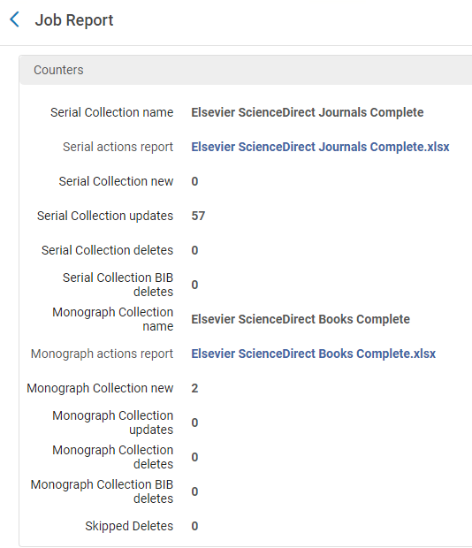
The update from Elsevier
Two KBART files were provided via the job by Elsevier
We will download these files and now look at three examples from these files.

Slide 17
The update from Elsevier – No Change to Resource

Slide 18
The update from Elsevier – No Change to Resource
This is part of the KBART file “Elsevier ScienceDirect Journals Complete.xlsx” supplied by Elsevier. Here we see for example that Journal “Taiwanese Journal of Obstetrics and Gynecology” ISSN 1028-4559:
  Is published from year 2004-03 (which is March 2004) vol. 43 issue1
  There was no change to the journal in this run of the job

Slide 19
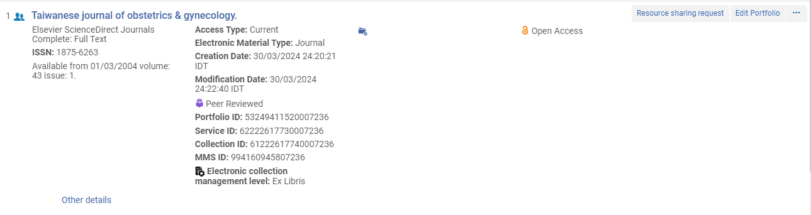
The update from Elsevier – No Change to Resource
Here is journal “Taiwanese Journal of Obstetrics and Gynecology” ISSN 1028-4559 in Alma
Last modification date is before the last time the job ran on July 20, 2024.
The coverage information which we saw in the KBART file

Slide 20
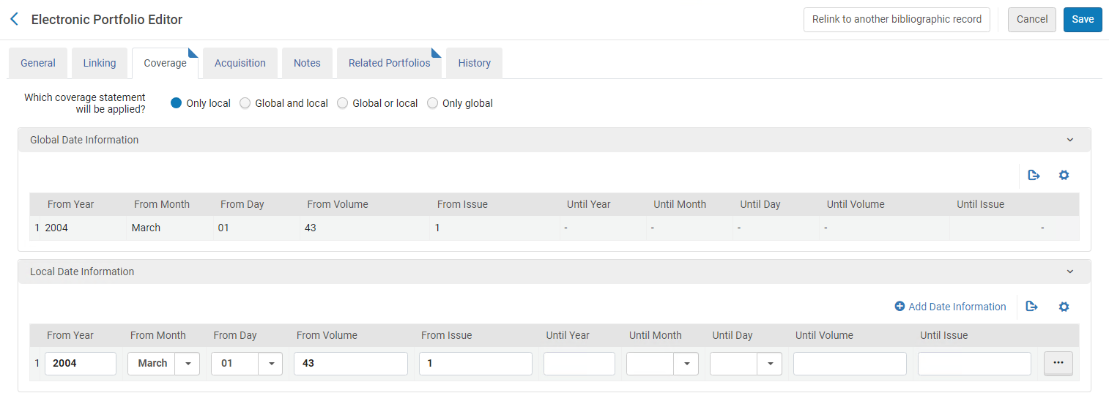
The update from Elsevier – No Change to Resource
The coverage information which we saw in the KBART file

Slide 21
The update from Elsevier – Resource Updated

Slide 22
The update from Elsevier – Resource Updated
This is part of the KBART file “Elsevier ScienceDirect Journals Complete.xlsx” supplied by Elsevier. Here we see for example that Journal “Taiwan Journal of Ophthalmology” ISSN 2211-5056:
  Is published from year 2011-12 (which is Dec. 2011) vol. 1 issue1 to year 2016-12 vol. 6, issue 4
  The journal was updated in this run of the job

Slide 23
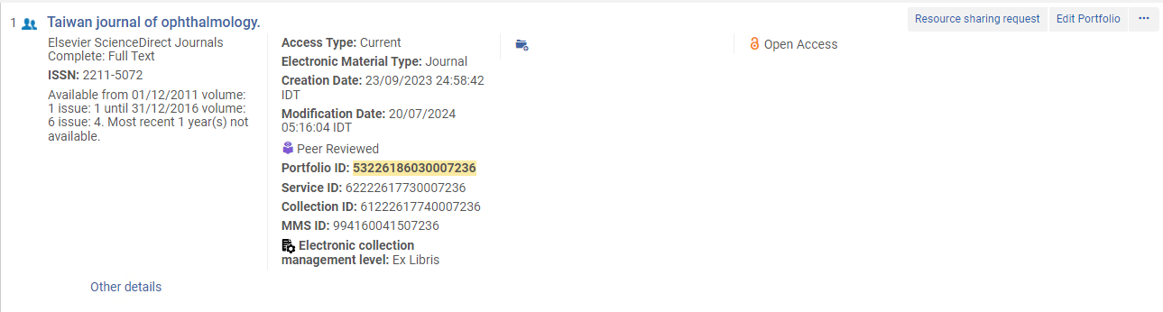
The update from Elsevier – Resource Updated
Here is journal “Taiwan Journal of Ophthalmology” ISSN 2211-5056 in Alma
Last modification date is the date of the last time the job ran on July 20, 2024.
The coverage information which we saw in the KBART file

Slide 24
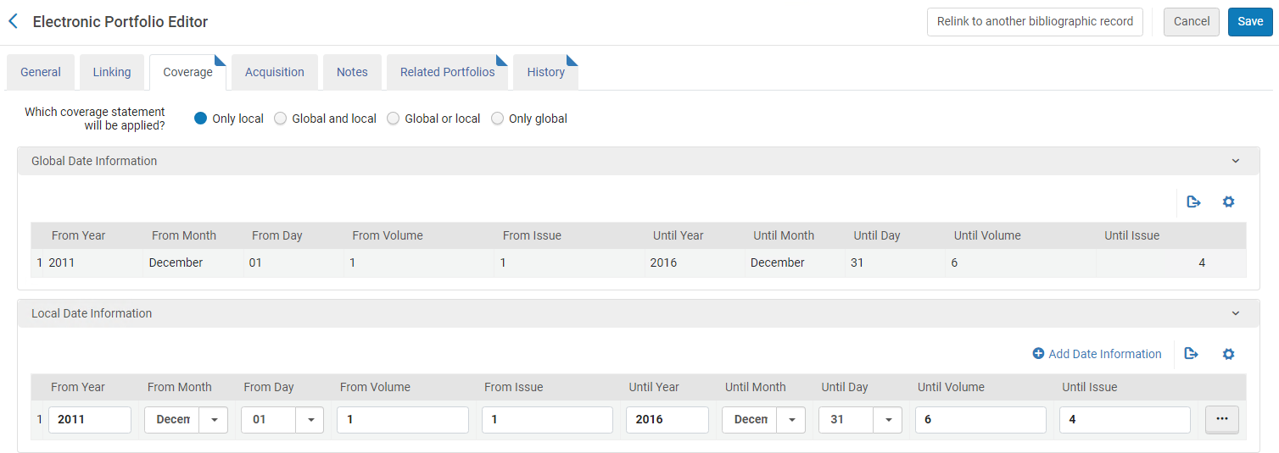
The update from Elsevier – Resource Updated
The coverage information which we saw in the KBART file

Slide 25
The update from Elsevier – Resource Added

Slide 26
The update from Elsevier – Resource Added
This is part of the KBART file “Elsevier ScienceDirect Books Complete.xlsx” supplied by Elsevier. Here we see for example that Monograph “Blood-Brain Barrier” ISBN 978-0-443-19404-7:
  Was localized and activated. This means it was added to the electronic collection
Coverage is not relevant for Monograph

Slide 27
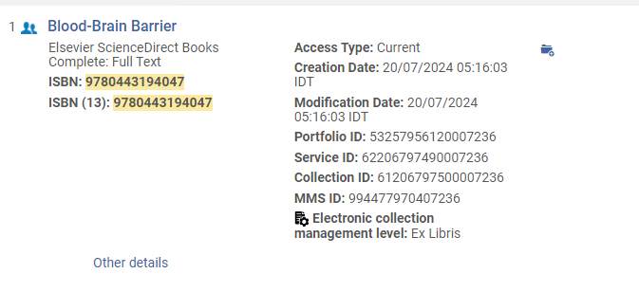
The update from Elsevier – Resource Added
Here is monograph “Blood-Brain Barrier” ISBN 978-0-443-19404-7 in Alma
Last modification date is the date of the last time the job ran on July 20, 2024.

Slide 28
Summary

Slide 29
Summary
After a simple setup the institution was able to automatically receive files from Elsevier, have them upload to Alma, and update the holdings of the electronic resources.
No manual work was done.
This is a great time saver, replacing the need to get the files from the vendor, make sure they are in proper format, and manually load to Alma.

Slide 30
Thank You

